Slide 1

(DAT301B) Data analysis 2
Week 1: Introduction
Amine Sijilmassi
amine.sijilmassi@um6p.ma

Slide 2
What do you know ? What do you expect ?
What do you know ? What do you expect ?
What do you know ? What do you expect ?
What do you know ? What do you expect ?
For Friday : fill survey

Slide 3
PART 1: Principles and course structure

Slide 4
Principles of this class
1. Project-oriented
2. Personal
3. Rooted in behavioral science
4. Technical skills are not enough
Notes:
This means, in this course, you will not have a lot lectures. Rather, you will work a lot on personal projects. I’m starting with this point because I suspect that this is the point that will be most unusual, and perhaps frustrating to you; because you will have to learn a lot by yourself. Don’t expect a class where you just learn your lesson and apply it. A lot of your time will be devoted to solve problems on your own.
This means that in this course you’ll get a lot of freedom to choose what you want to work on, what kind of data, and what techniques you want to use
This one is very important. The ability to ask good, relevant and precise questions, and to communicate results effectively, is as important as writing a good program
Related to ths point above, ultimately data analysis is a tool: the most complex tools are not necessarily the best; what matters is that the analysis we do helps us answer the question

Slide 5
The class is structured around two research reports where you analyze real data
Why?
1. Working on a concrete project is the best way to learn
2. There is an infinite world of data analysis techniques to learn: working on projects allow you to focus on those that are useful to you
3. Some of the most important skills in data science cannot be learned in lectures (e.g. understand a codebook, understand a dataset…)
4. I want you to build a portfolio of real data analysis
Notes:
1. I want to stress this point, because you’ll do a lot of work in autonomy; and most importantly, you’ll do a lot of work on your own projects. There are three reasons for this. The first is that in my experience, working on a research project is the best way to learn, especially when it relates to programming. The second is a pragmatic

Slide 6
Technical skills are not enough :
Generate an interesting, novel, precise hypothesis
Determine which data analysis strategy is best to test the hypothesis
« Technical » skills
Code the data analysis in R
Programming
Communicate results effectively (write up a research report, visualize data…)

Slide 7
Evaluation
(20%) Two research reports (10% each ; part of the note is oral presentation)
(30%) Midterms: 2-hour pen-and-paper analysis of a real dataset in class
(40%) Final exam: 3-hour pen-and-paper analysis of a real dataset in class
(10%) Participation & attendance (includes the quality of the short test; interventions in class)

Slide 8
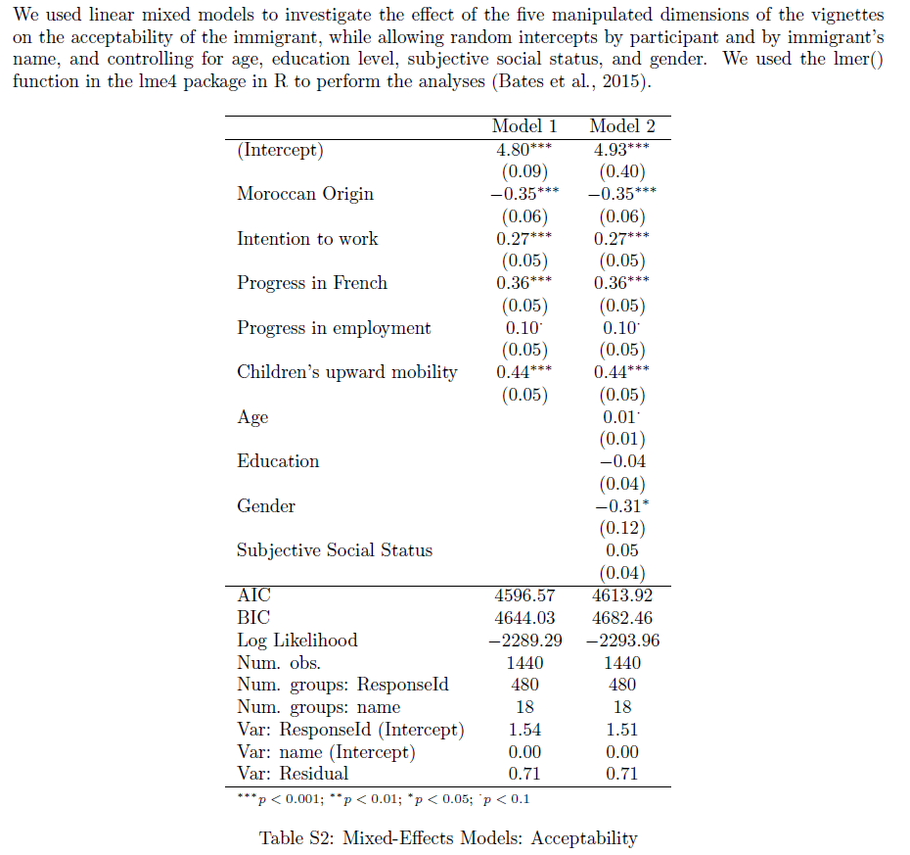

Slide 9
Syllabus

Slide 10
Organization of the class
In class
(5 minutes) short quizz on Canvas on class material from the previous week
(15 minutes) Q&A discussion on previous homework
(Remaining 1h20 or 2h20) Practical work (TP) data analysis concepts
At home
Mandatory readings
One additional step in your research reports
Office hours
Weekly schedule : TBD, but always e-mail me first.

Slide 11
PART 2: Principles of the research report

Slide 12




Tools

Slide 13
What is a good research question in behavioral science ?
1. Start with a strong question about human behavior
Paradox ; something that strikes common sense (e.g. Why do people listen to sad music?; Why do people under-register to social programs ?)
Something that speaks to large social science (or political) debates (e.g. Are gender differences in behavioral tendencies universal ? Do laws change public opinions or the opposite?)
Something for which you have multiple credible hypotheses (e.g. yes, gender differences are universal because they derive from biological adaptations vs. No, they are shaped by culture thus they vary)
Forbidden :
Questions non-related to behavior ; or for which the connection to behavior has not been made apparent (e.g. did agricultural yields increase? Does inflation slow down economic growth?)
Questions without strong justification (e.g. does education predict time spent listening to music?)

Slide 14
2. Define with great precision multiple hypotheses that might answer this big question ; and say which one you favor (and why)
3. Operationalize your hypothesis : say specifically what, in your data, corresponds to the main concepts in your hypothesis
Conceptual realm : « People prefer songs that evoke happy feelings rather than sad feelings »
Operationalization (the reality of my dataset that should confirm the conceptual hypothesis) : « In my dataset of Spotify tracks, more popular tracks are higher in perceived valence (a 0 to 1 measure with 1 meaning happier songs), as measured by a trained algorithm »
4. Identify a target audience

Slide 15
Mindset
There are no universal truths in data science
Ambiguity is uncomfortable but you need to embrace it
Notes:
For every single problem, you can have multiple ways to solve it. Worse than this, very intelligent people will disagree on which one is the best. Also, every dataset and every research question is different. I can only teach you some general rules, but you always need to keep a critical mind

Slide 16
Research report example: Spotify data

Slide 17
PART 3: Choosing your registered reports

Slide 18
Criteria
Think about your Master’s
Think about your research prospects/your portfolio
Think about your interests: it should be fun
Think of what behavioral science can uniquely contribute compared to other « data experts » (physicists, economists…): e.g. human-ai interaction, consumer behavior, political behavior…
Think of what is novel: I expect you to run novel analyses, not replications

Slide 19
PART 4: Autonomy

Slide 20
How do you get help?
15-minutes rule
Use ? In R to access documentation
Ask Google
Look at other people's code (e.g. my template; or ask around)
Search in your readings
… after 15 minutes of independent work, ask me

Slide 21
How do you get help?
What about AI?
We won't use it for the first few classes
You can use it for your registered reports, but remember that 50% of your grade comes from in-class exams where you won't have access to AI

Slide 22
FOR NEXT WEEK:
Readings
Finish Titanic if not finished in class
Create a Github account
Choose a dataset to analyze for Research Report 1 and elaborate a research question

